Slide 1
Cloud Expert
Amazon Web Services

Slide 2


AWS System Tools

Slide 3

AWS Systems Manager
“A collection of capabilities to help you manage your applications and infrastructure running in the AWS Cloud. Systems Manager simplifies application and resource management, shortens the time to detect and resolve operational problems, and helps you manage your AWS resources securely at scale.”

Slide 4
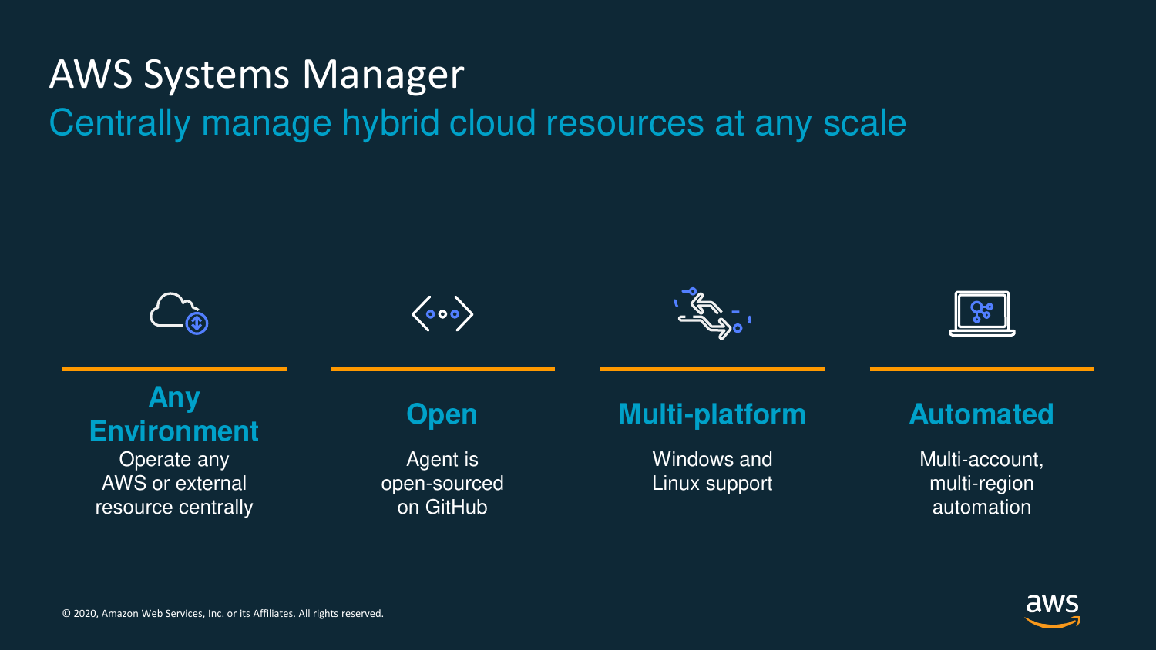

Slide 5
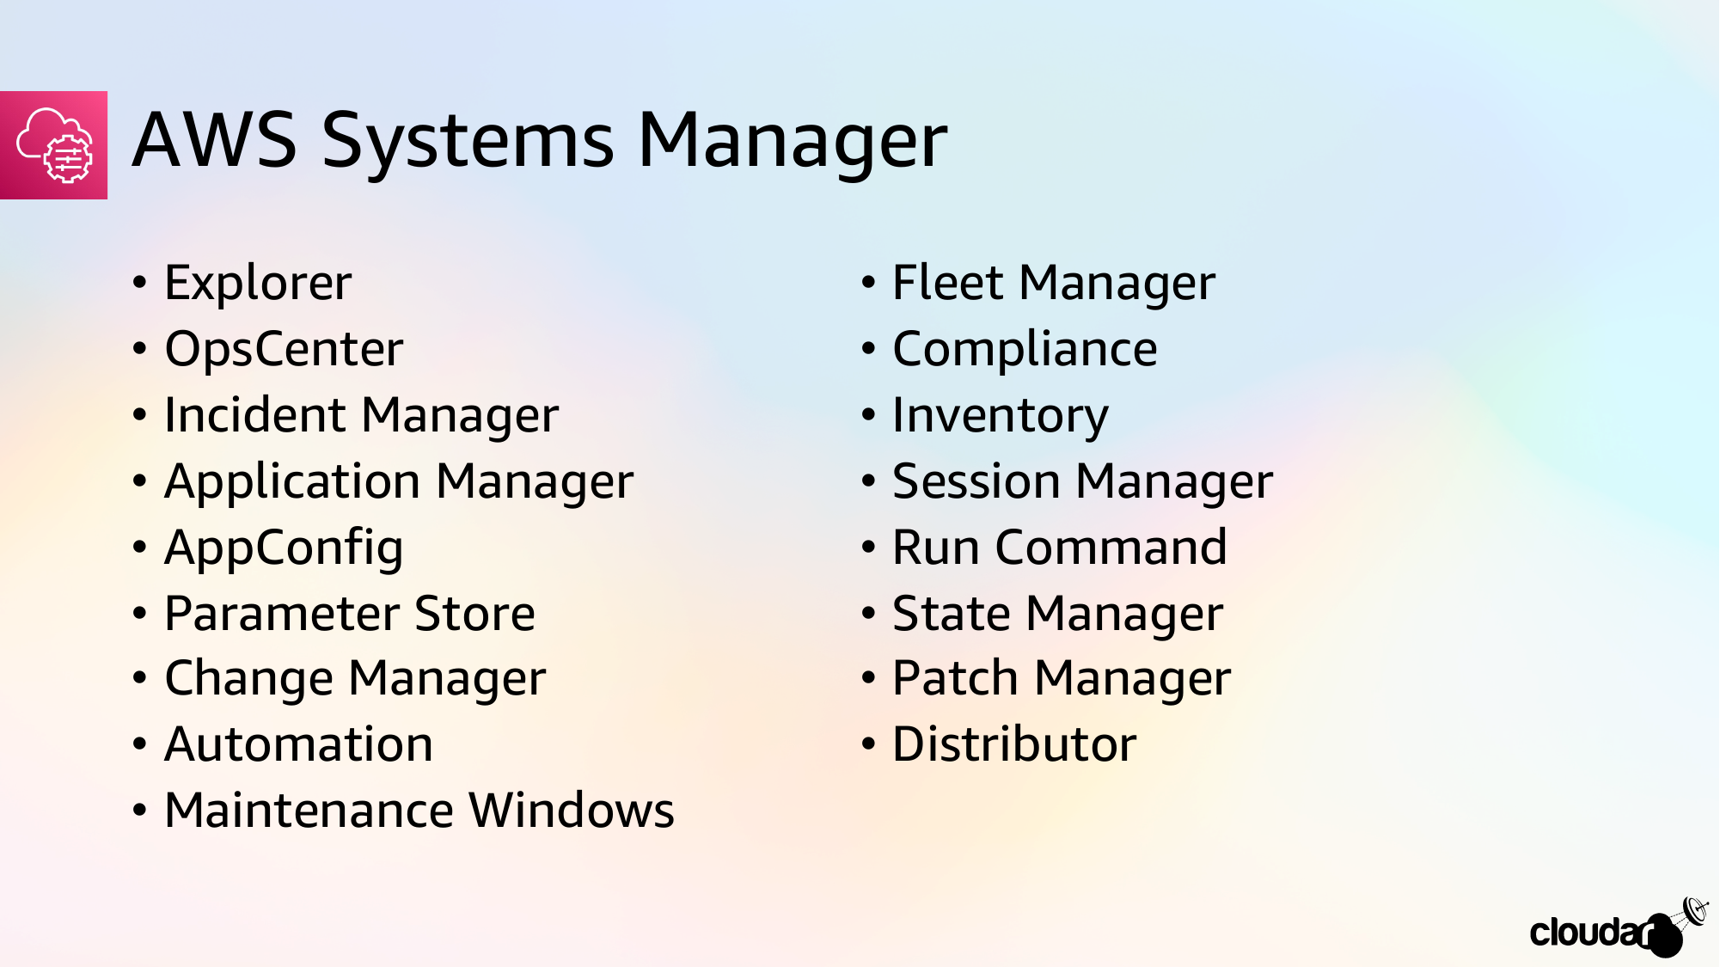


Slide 6
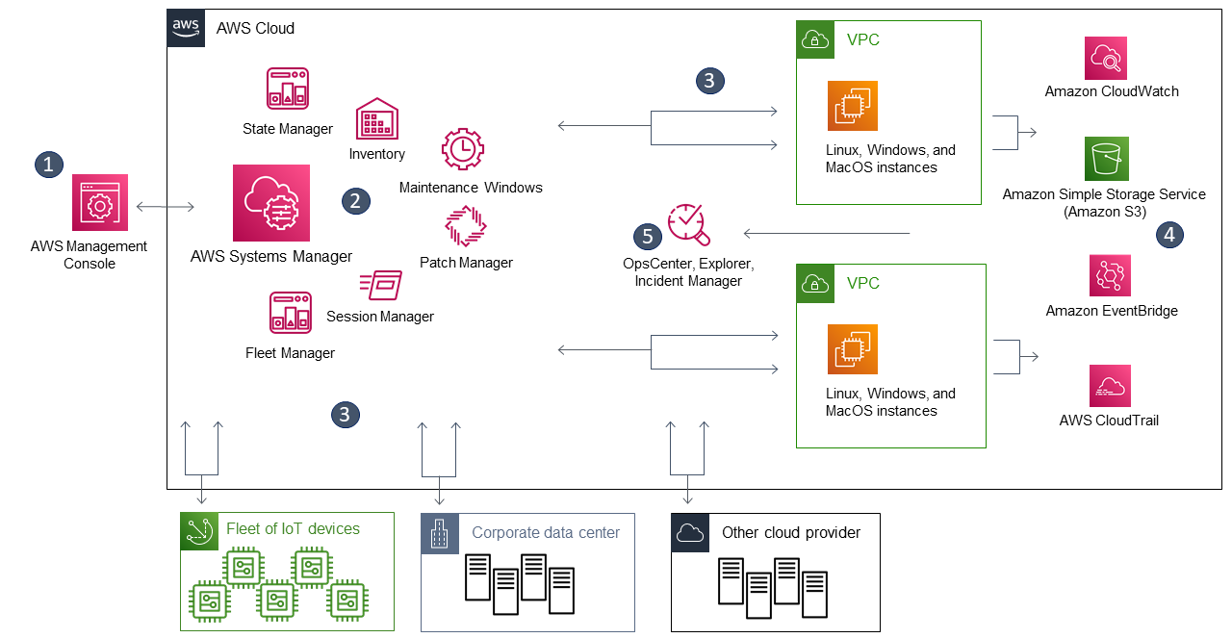
AWS Systems Manager
Notes:
Access Systems Manager
Choose a Systems Manager capability
Verification and processing
Reporting
Systems Manager operations management capabilities

Slide 7
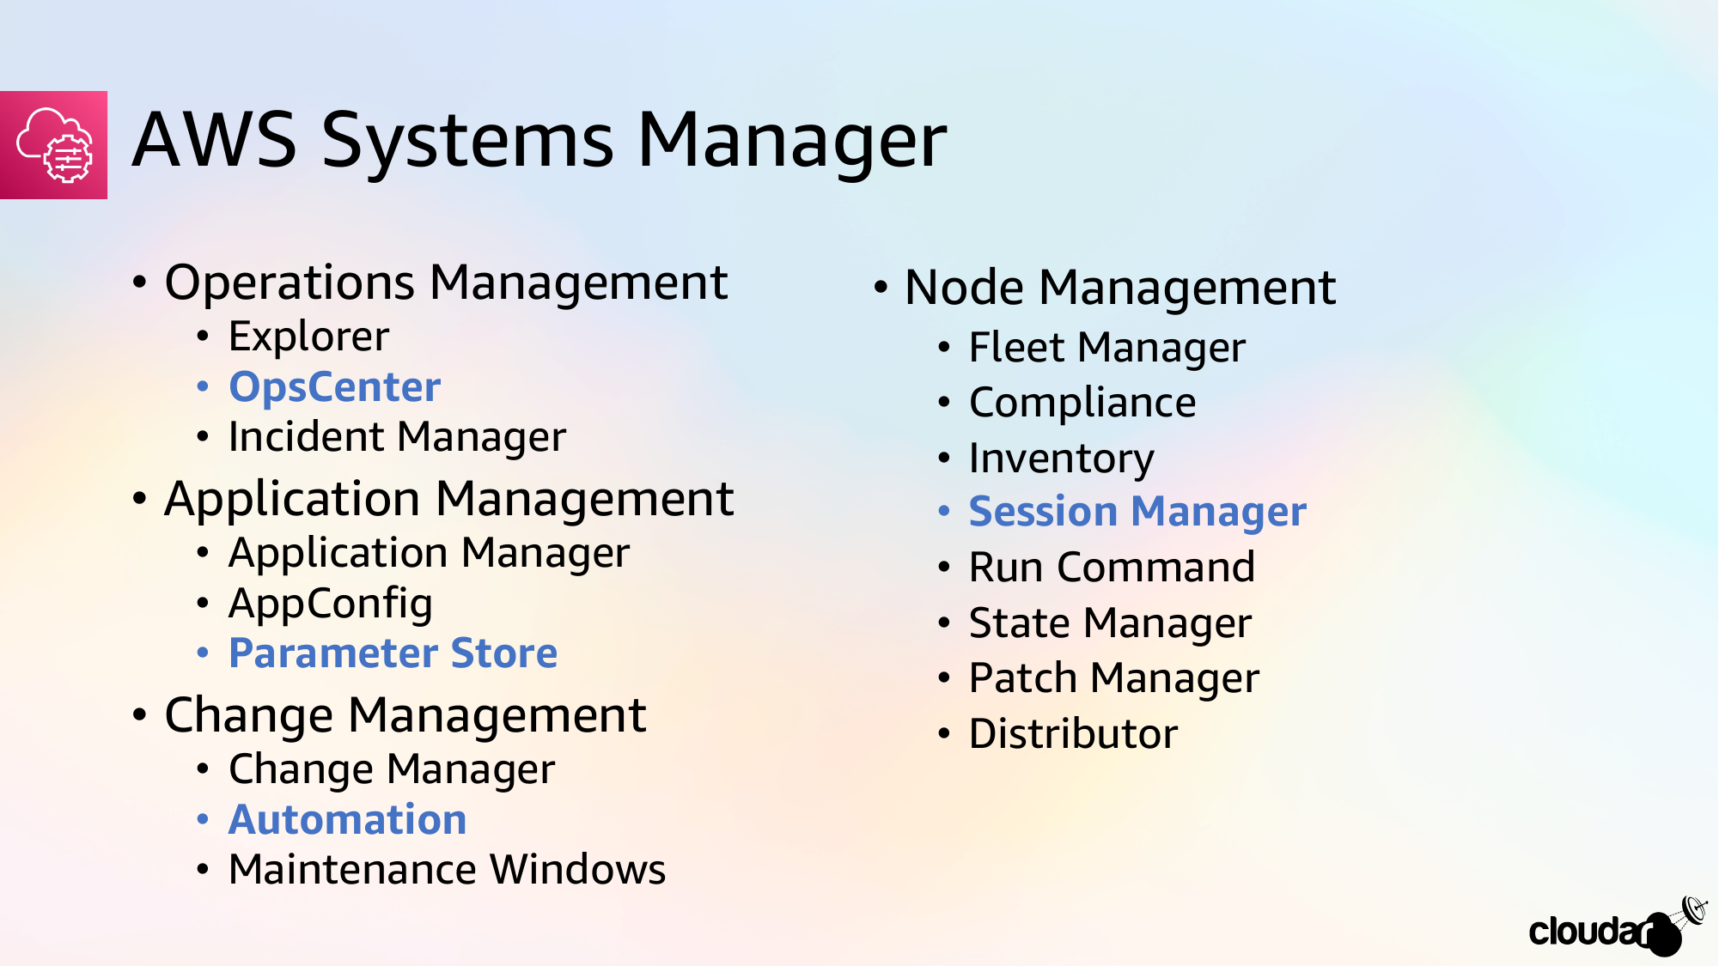

Slide 8
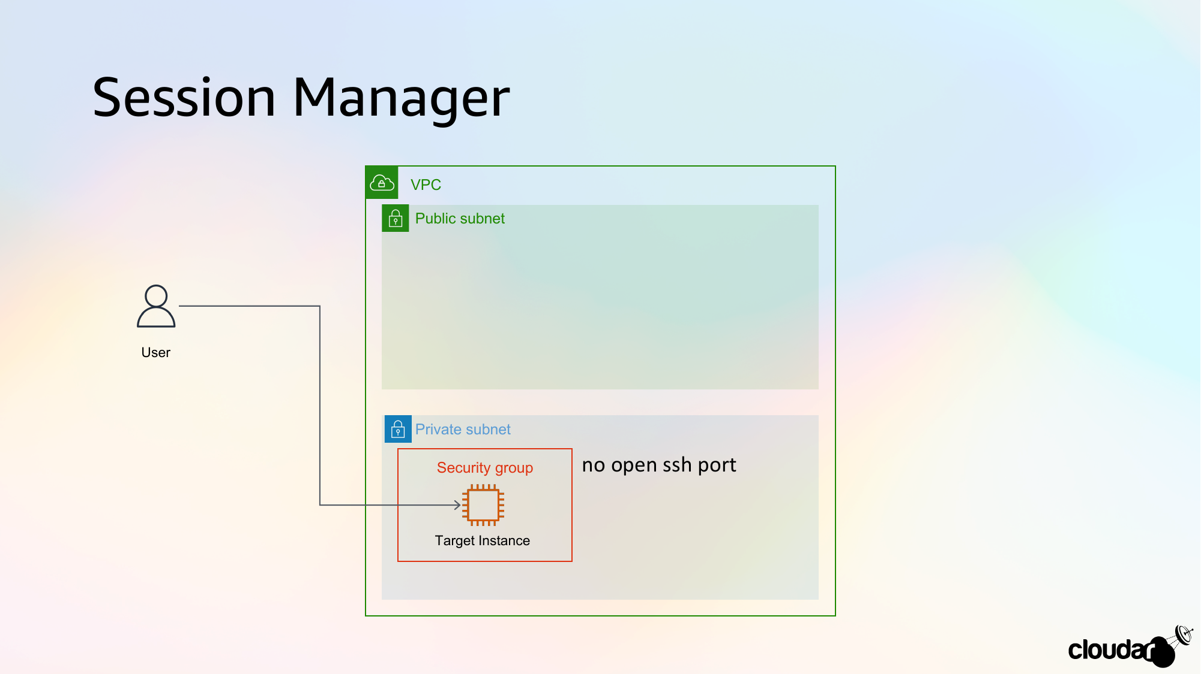

Slide 9
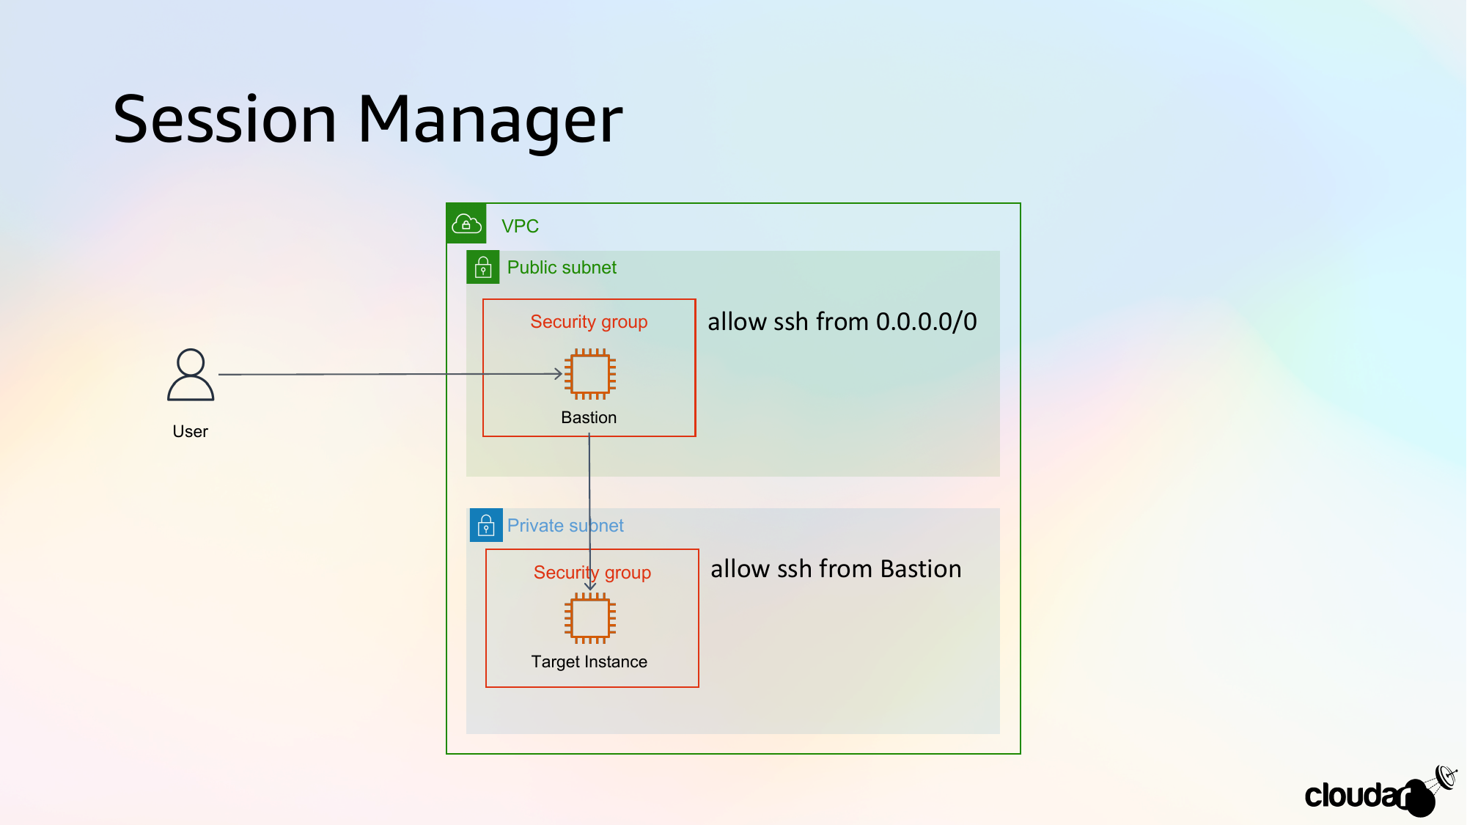

Slide 10
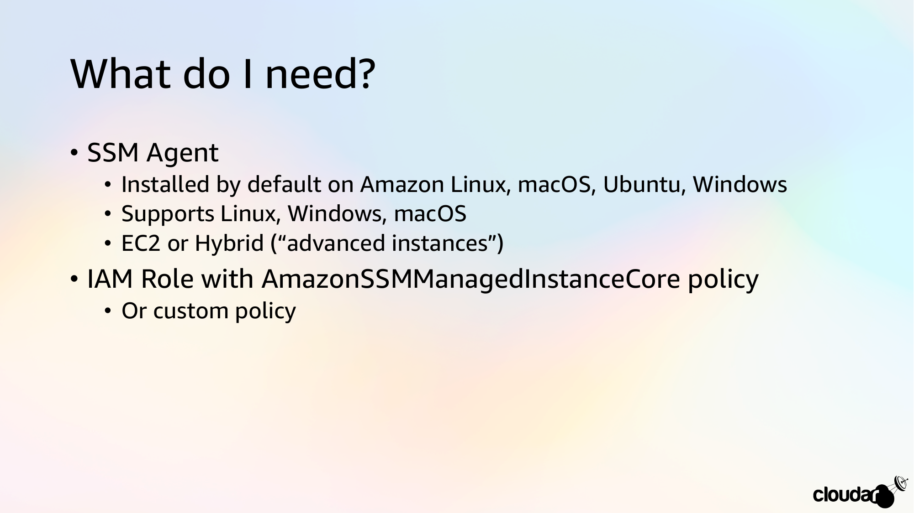

Slide 11
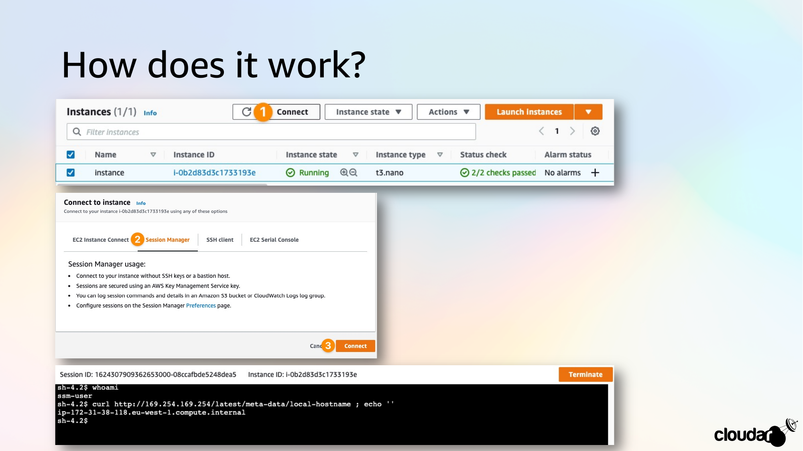

Slide 12
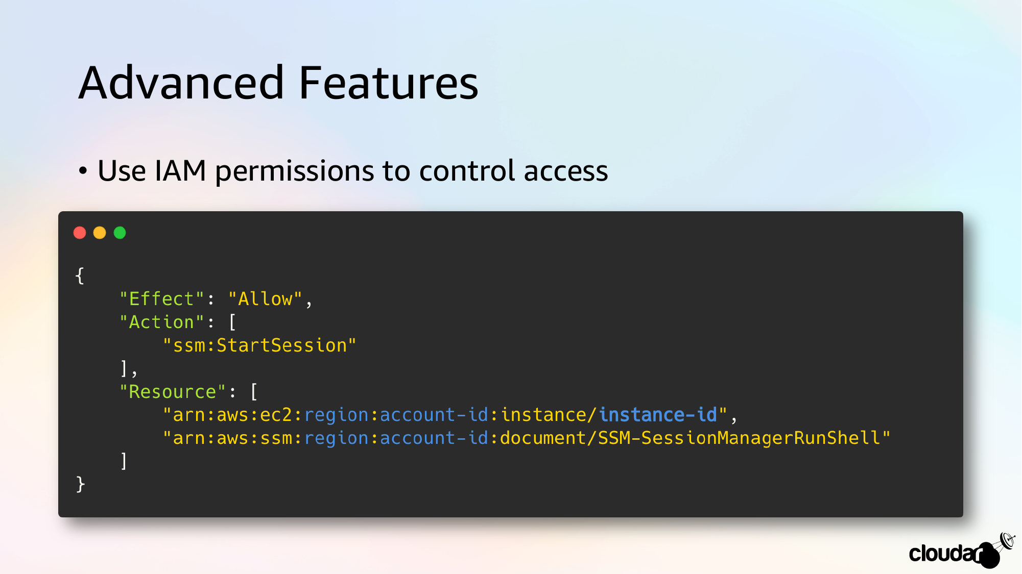

Slide 13
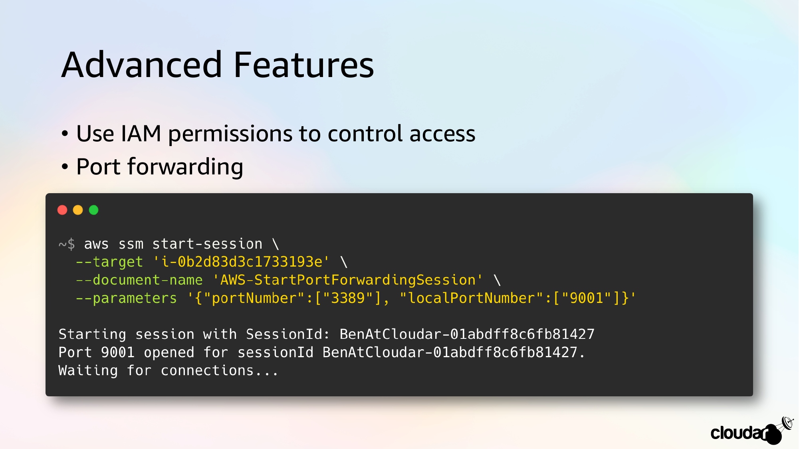

Slide 14
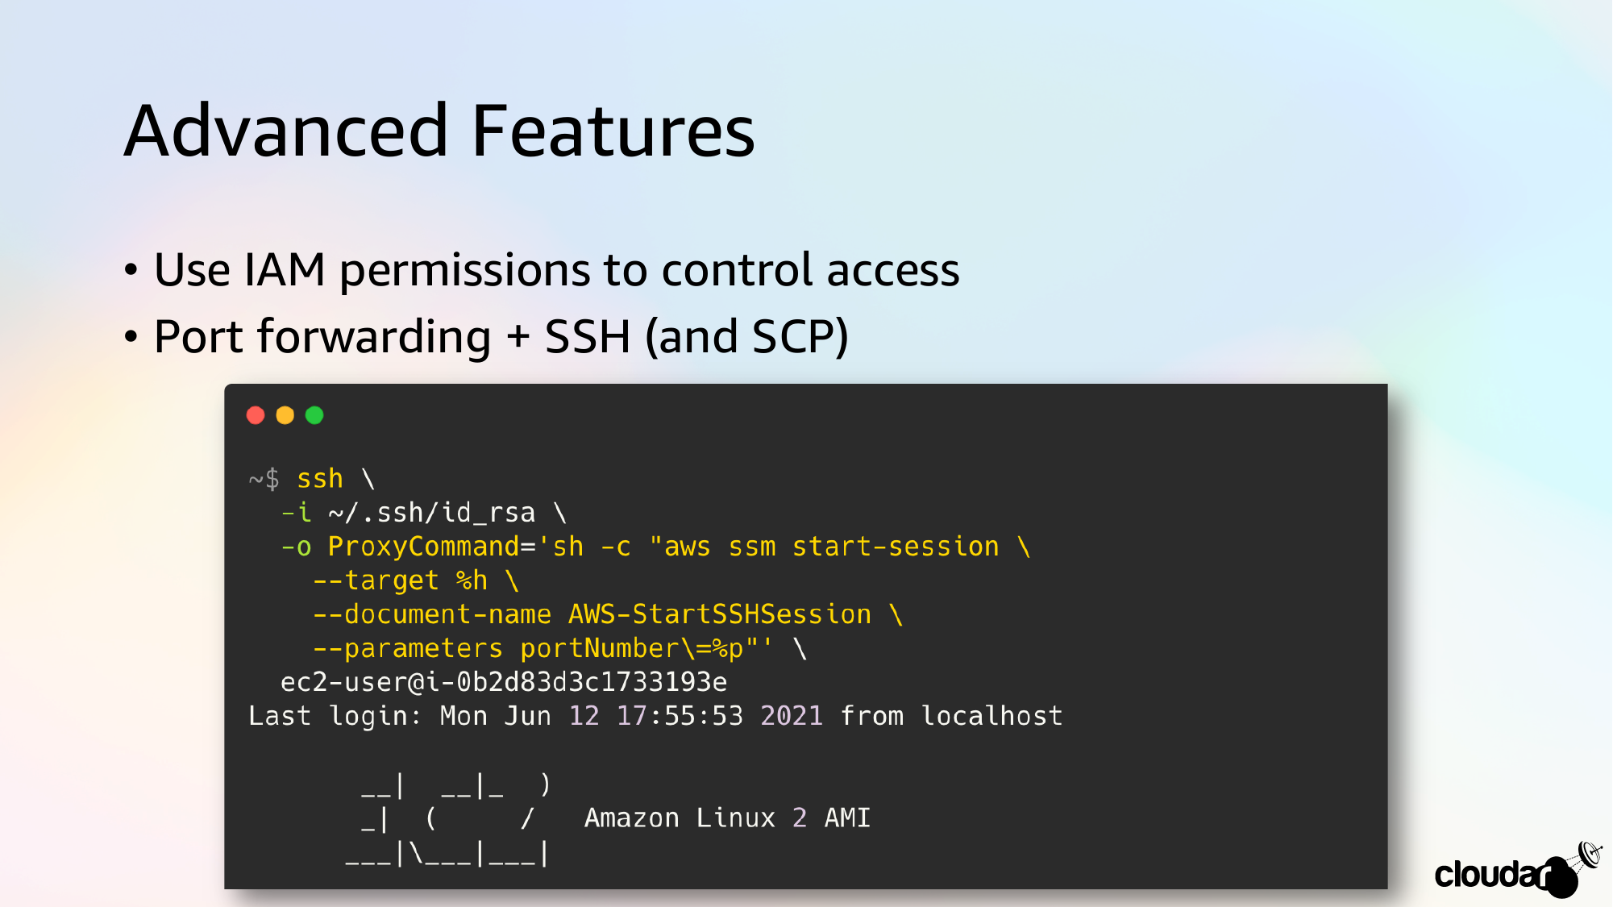

Slide 15
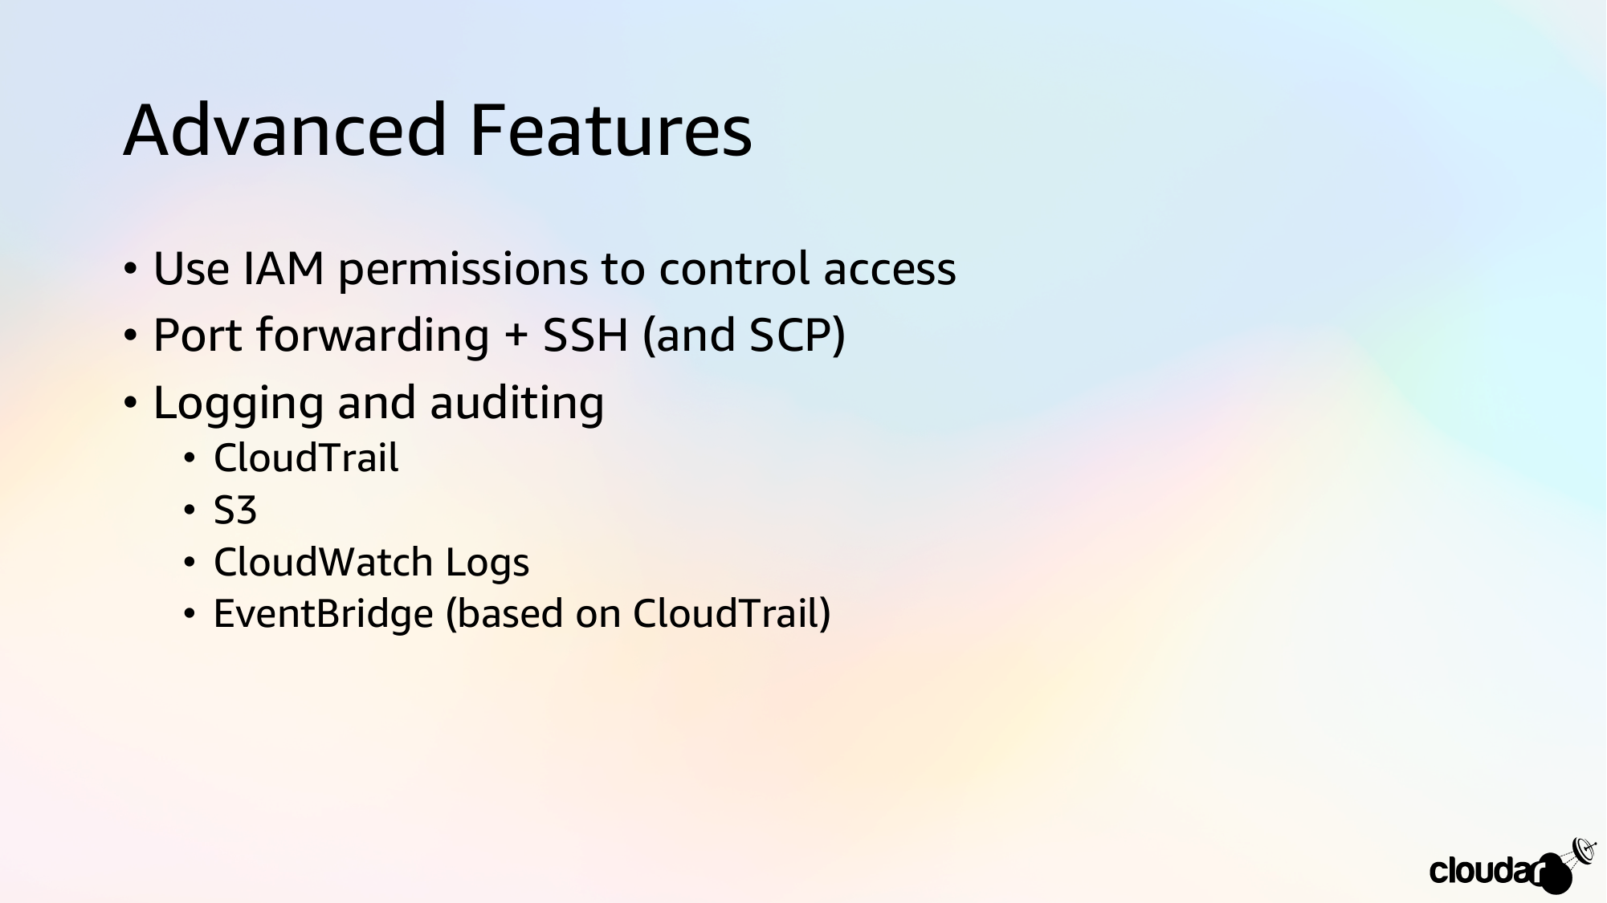

Slide 16
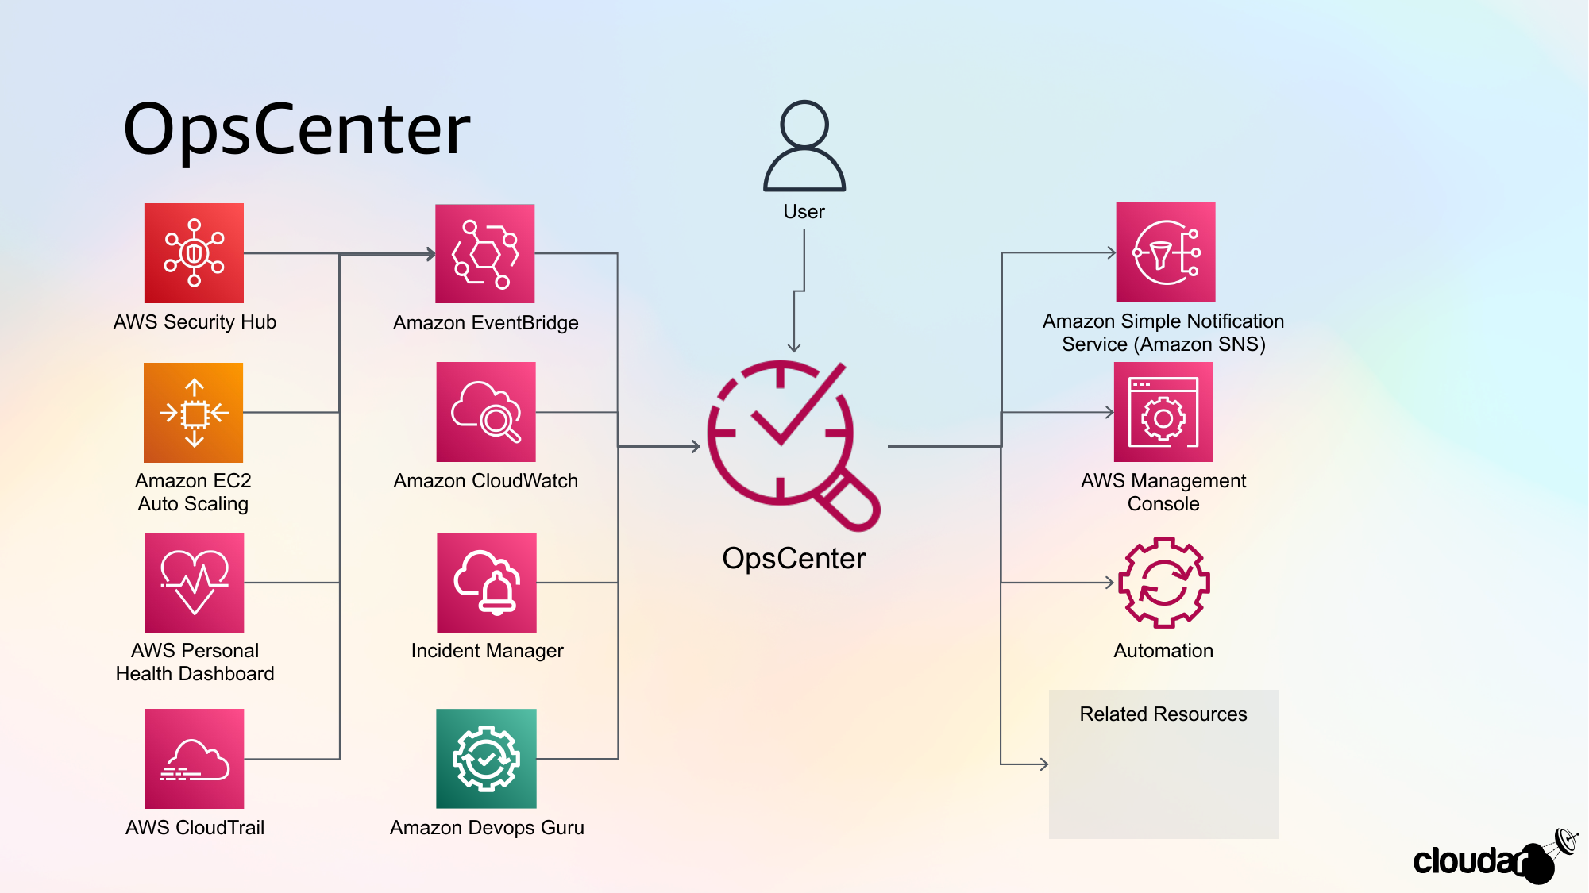

Slide 17

OpsCenter
Centrally diagnose and remediate issues with dashboards
Use Cases
Remediate Operational Issues
Security or Performance Issues
Failures and AWS Health alerts
Resource State Changes
Monitor Patch Compliance
Review instance count and AMI usage
Key Features
Gain insight into operations issues
View operations data across AWS accounts/Regions
Aggregates information from native AWS services
(AWS Config, AWS CloudTrail, Amazon CloudWatch Events, etc.)

Slide 19

Parameter Store
Secure, hierarchical storage for configuration data management and secrets management
Use Cases
centralized way to manage configuration data.
store different logins and reference streams.
receive notifications when secrets and passwords are or aren't changed.
Key Features
Change notification
Organize and control access
Label versions
Data validation
Reference secrets
Accessible from other AWS services
Integrate with other AWS services

Slide 20
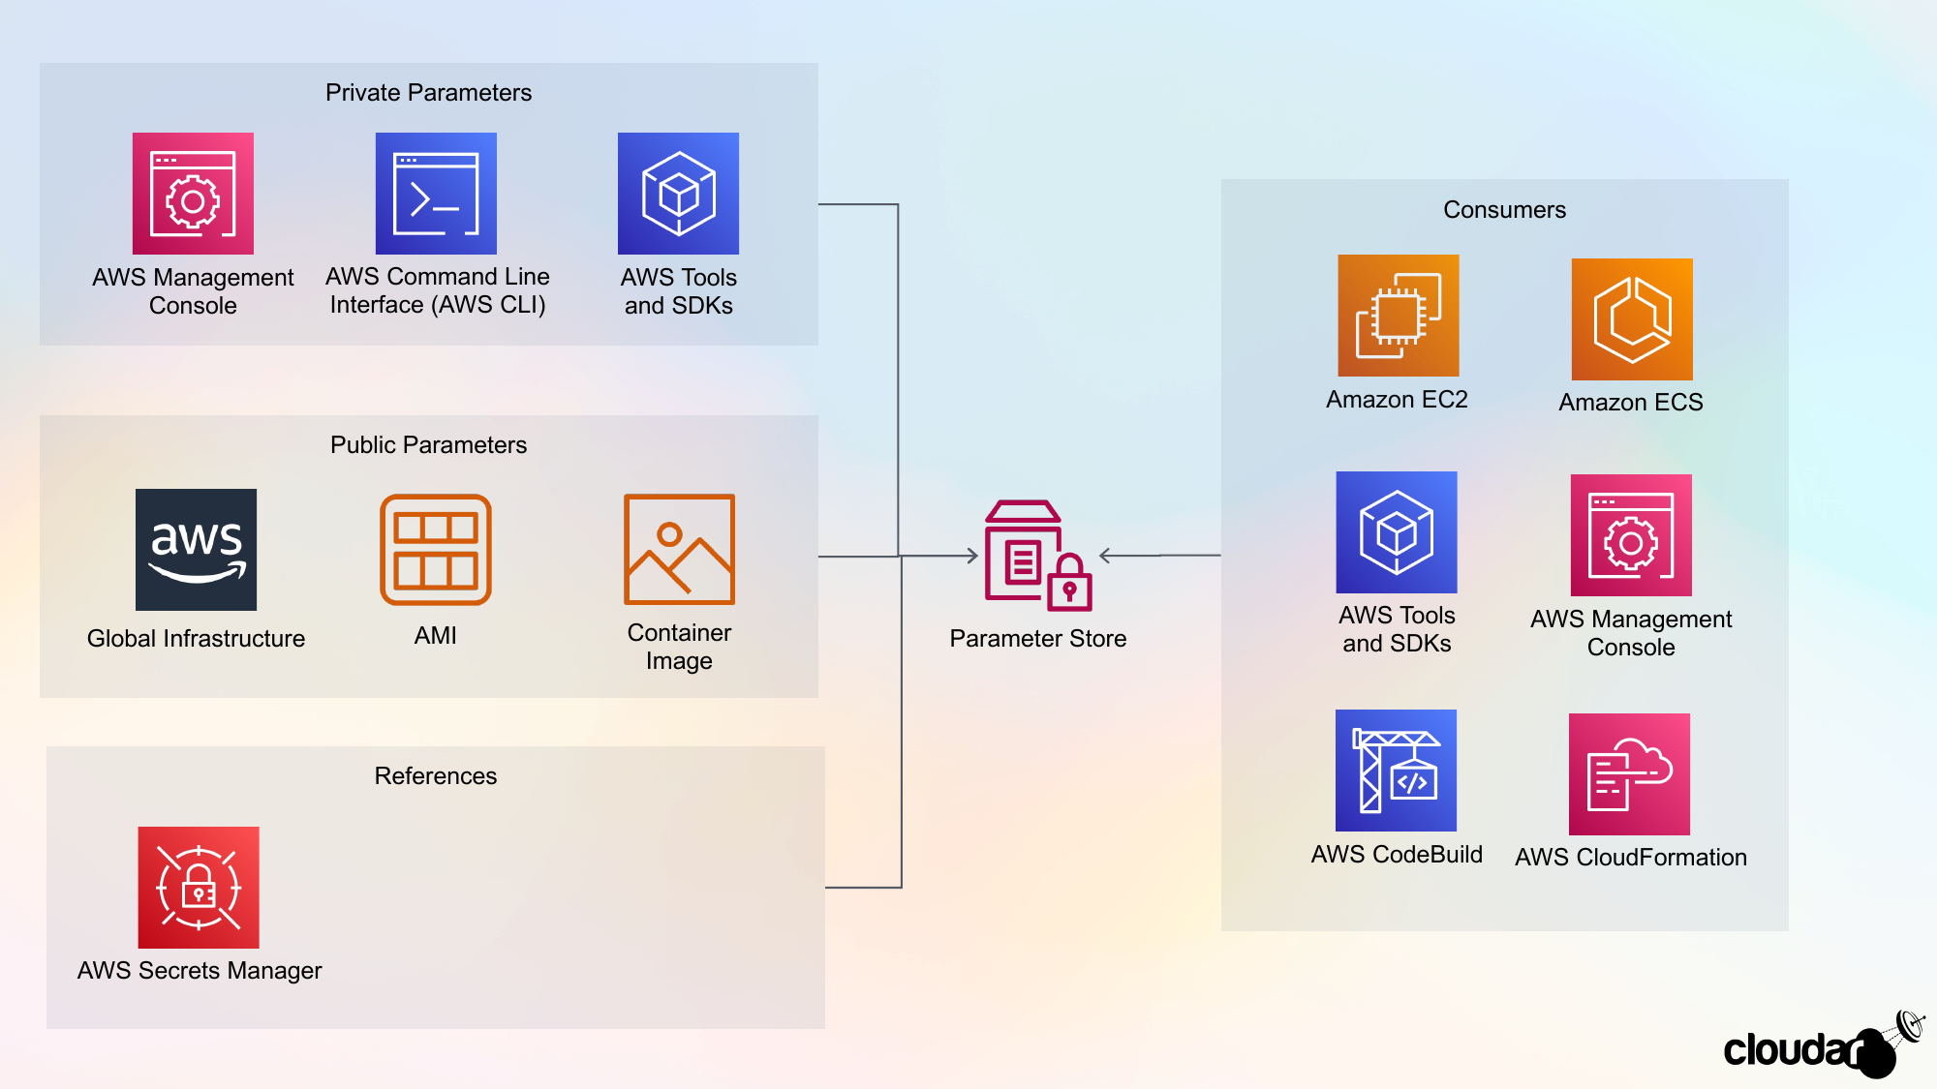

Slide 21
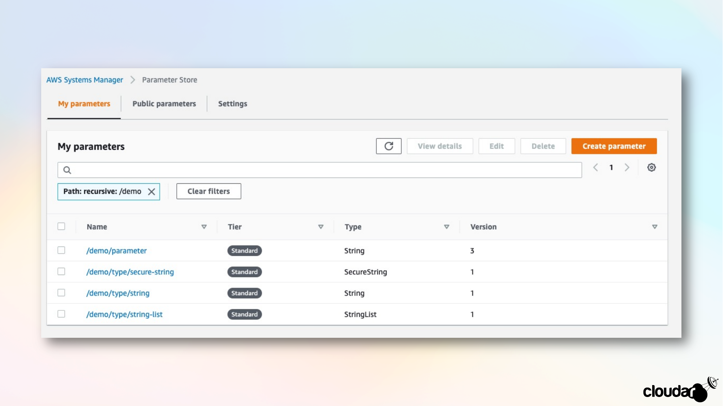

Slide 22
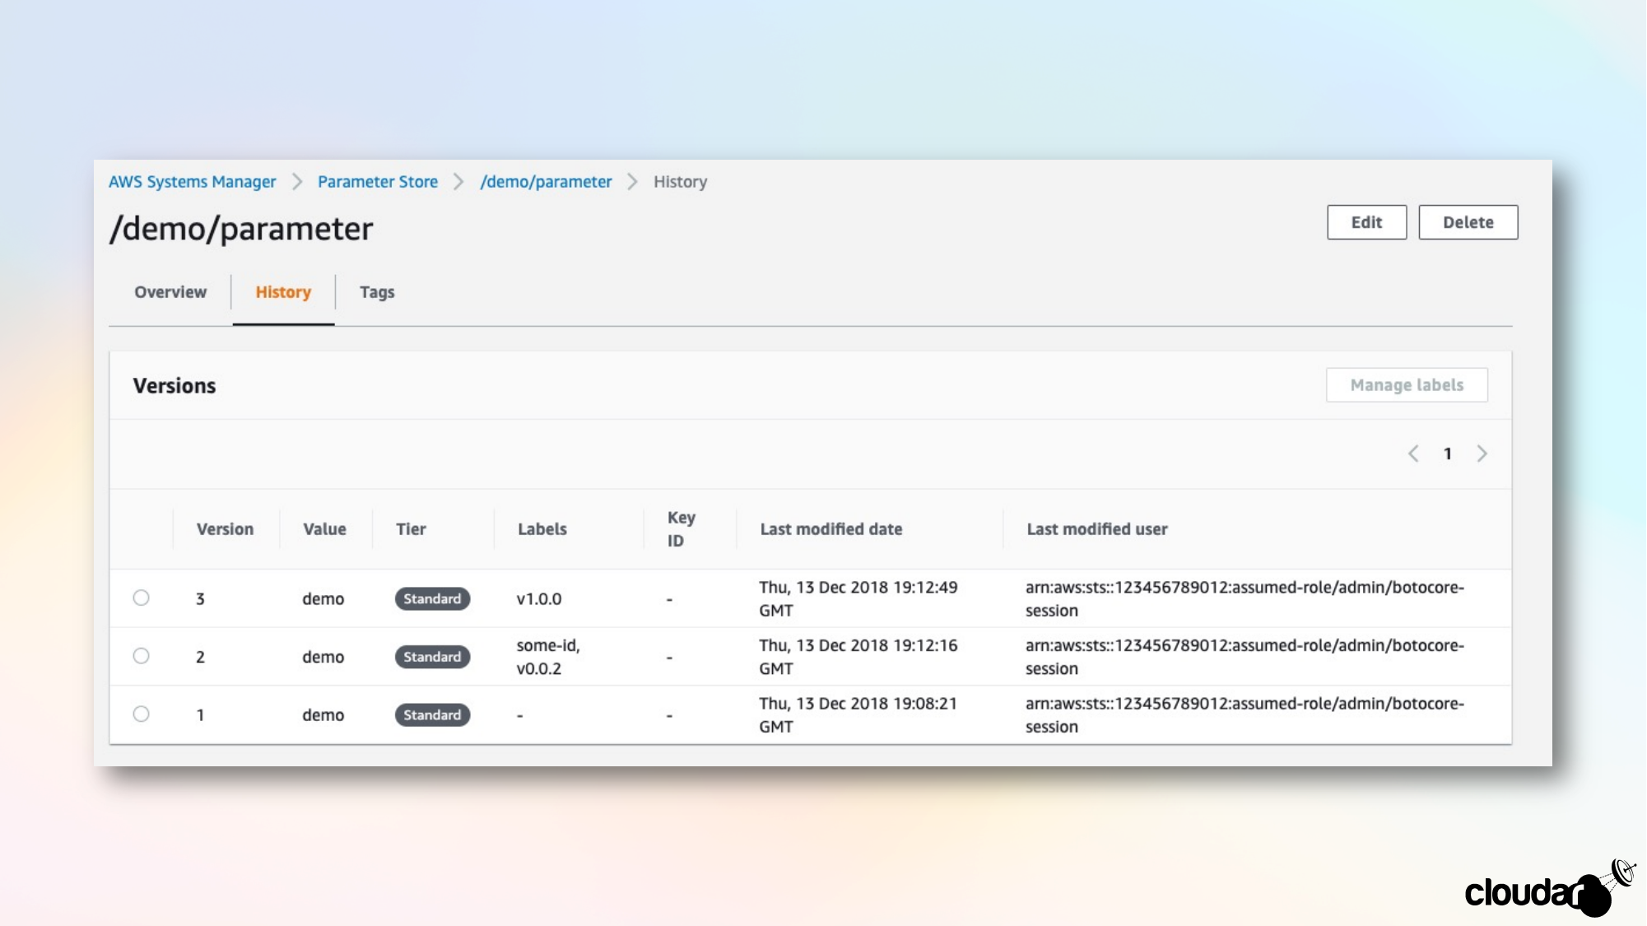

Slide 23
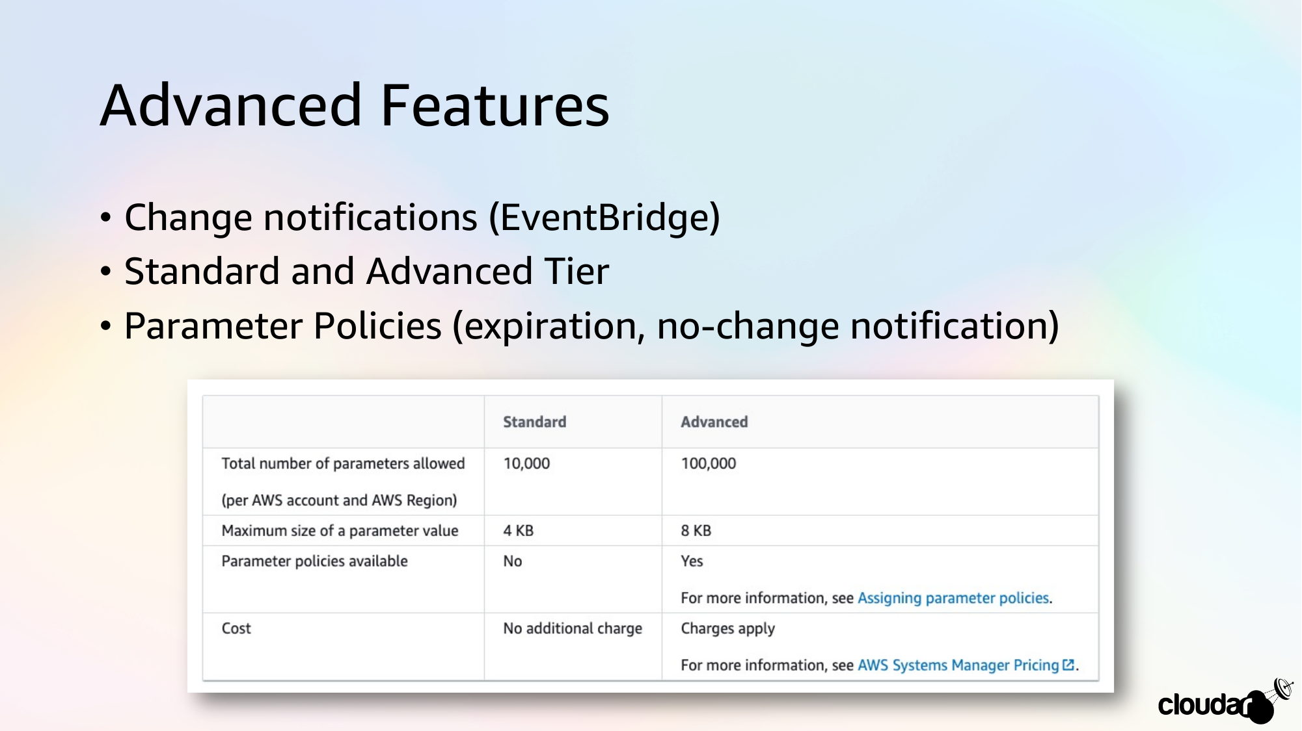

Slide 25

Automation
Simplifies common maintenance, deployment, and remediation tasks for AWS services
Use Cases
One-click configuration tasks
Performing routine maintenance tasks
Automatic remediation through AWS Config
Stopping EC2 instances with approvals
Taking backups of AWS resources (e.g. DynamoDB)
Key Features
Scripting support in runbook content
Run automations from a centralized location
Enhanced operations security
Safely perform disruptive tasks in bulk
Define constraints for inputs
Log automation action output to Amazon CloudWatch Logs
Share organizational best practices

Slide 26
How does Automation work?
Assumes current user context by default
Option to specify service role
Leverage AWS provided playbooks
Create custom Automation documents
Define actions to perform
Provide dynamic parameters
Conditionally branch based on step results
Configure approvals as part of workflow
Run the Automation playbook
Multi-account and multi-Region
Register as a Maintenance Window task
Remediation with OpsCenter
Trigger based on CloudWatch Event rules
Automatic remediation with AWS Config

Slide 27
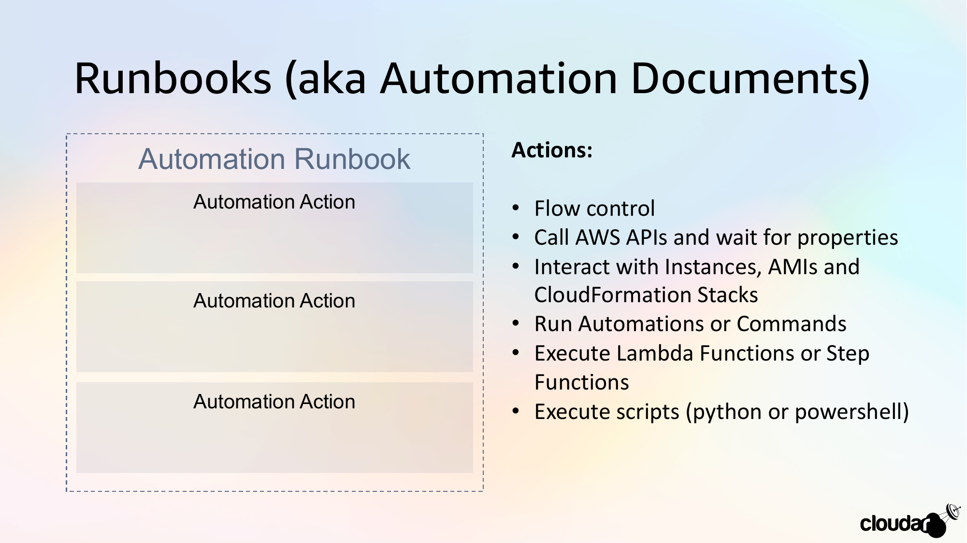

Slide 28
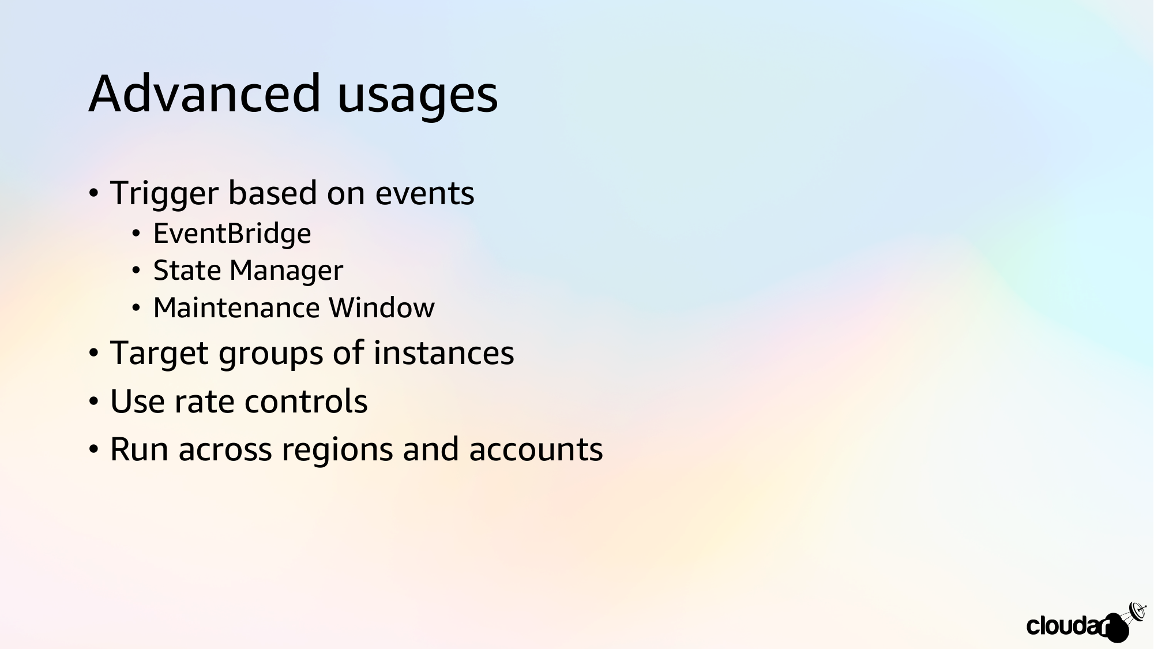

Slide 29

Extra leermaterialen & labs
Lab: https://cloudexpert.dubbadub.be/#/2_system
https://docs.aws.amazon.com/systems-manager/
Bronvermelding slides:
Ben Bridts (Cloudar): https://speakerdeck.com/benbridts/aws-systems-manager
AWS Techtalk: https://pages.awscloud.com/AWS-Systems-Manager-Gain-Operational-Insights-and-Take-Action-on-AWS-Resources_2020_0220-MGT_OD.html

